Slide 1
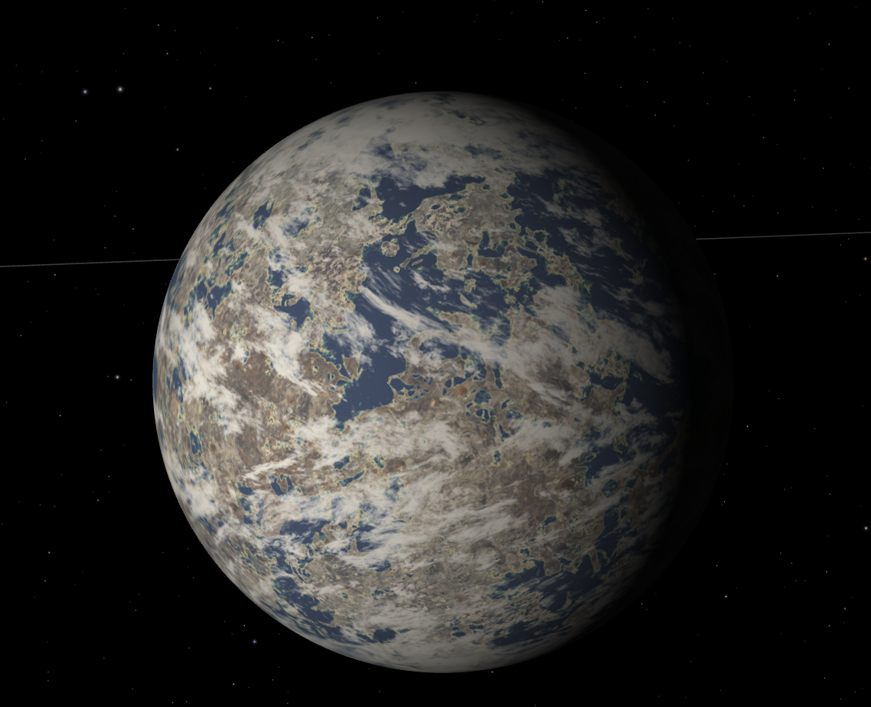


Habitability and Potential for Life on TRAPPIST-1e
NASA SPACE GRANT
Saturday, APRIL 19th -20th, 2023
Space Grant Statewide Symposium
Cameron Hrabak
Northern Arizona University
Dr. Christopher Doughty Dr. Michael Gowanlock

Slide 2
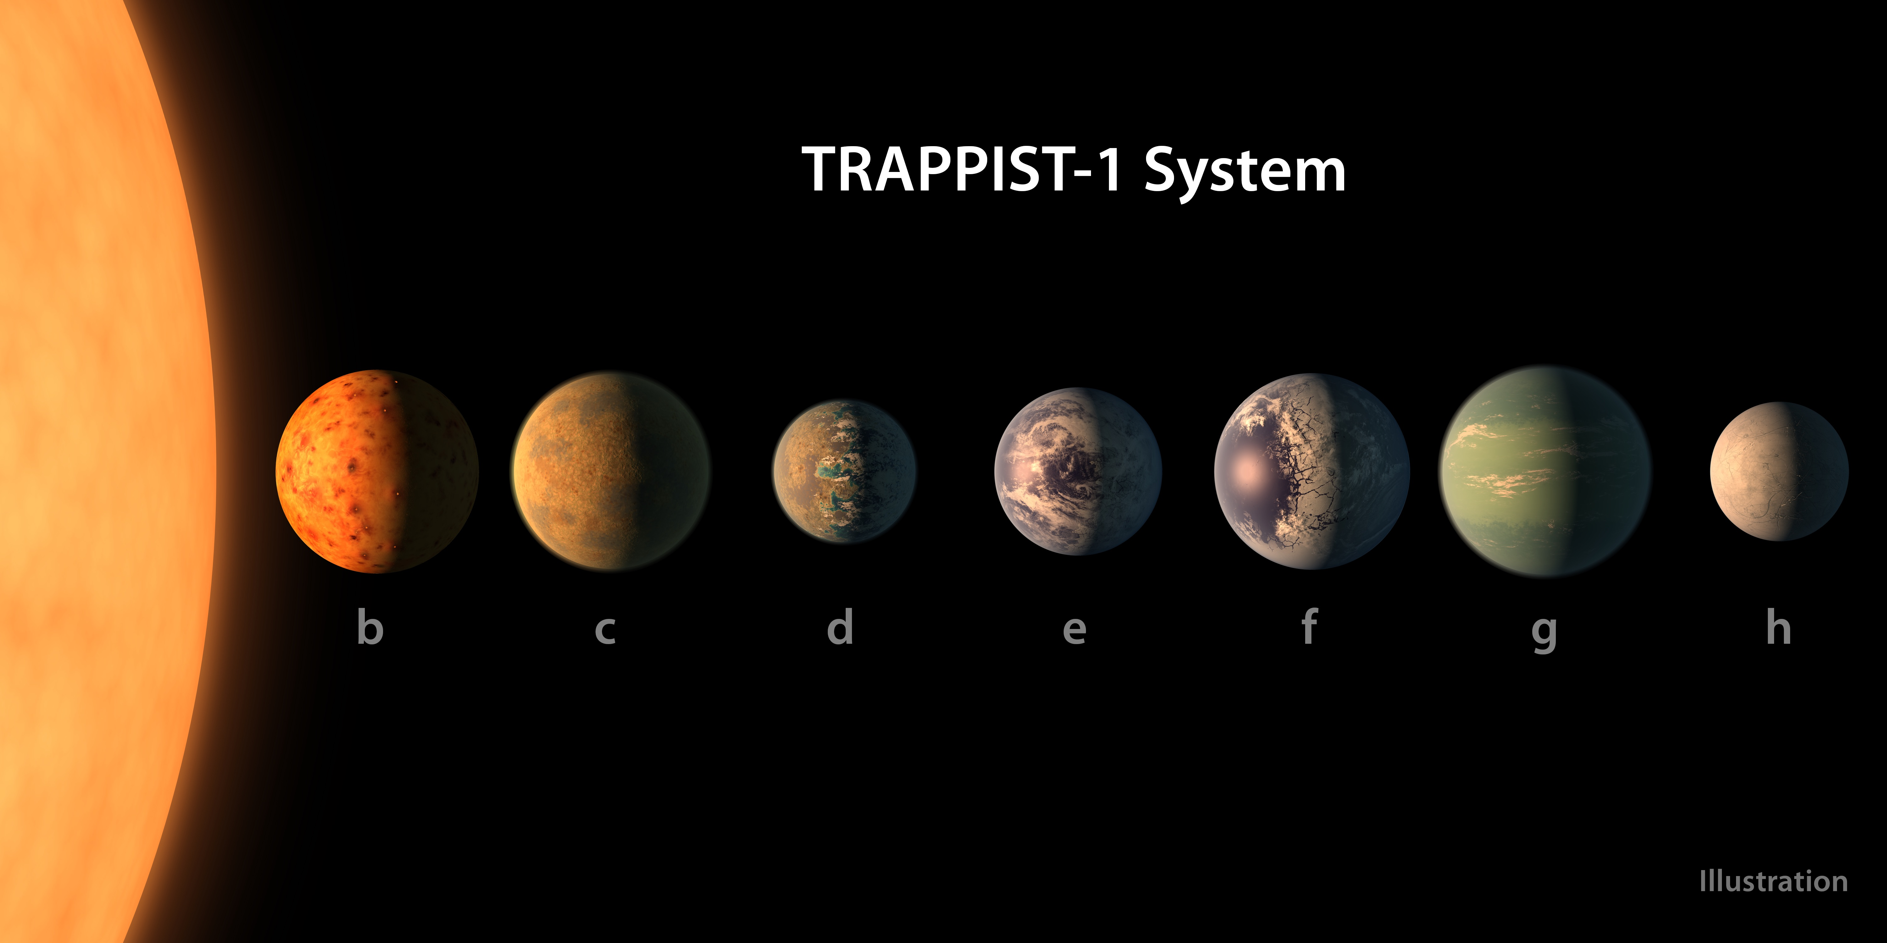

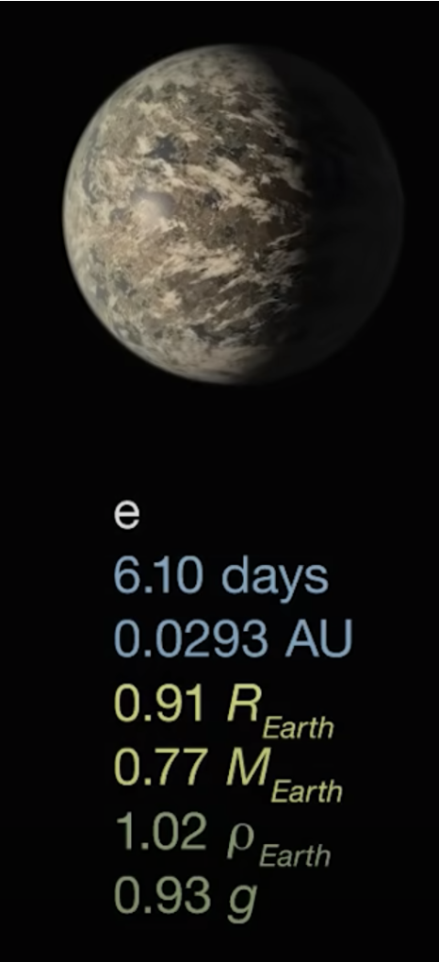
What is TRAPPIST-1e?
T R A P P I S T-1 P L A N E T A R Y S Y S T E M
TRAPPIST-1 is a planetary system that lies 40 light years away
There exists 6 planets, named TRAPPIST-b-g
TRAPPIST-1e exists within the ”goldilocks” zone similar to that of Earth, but remains tidally locked

Slide 3
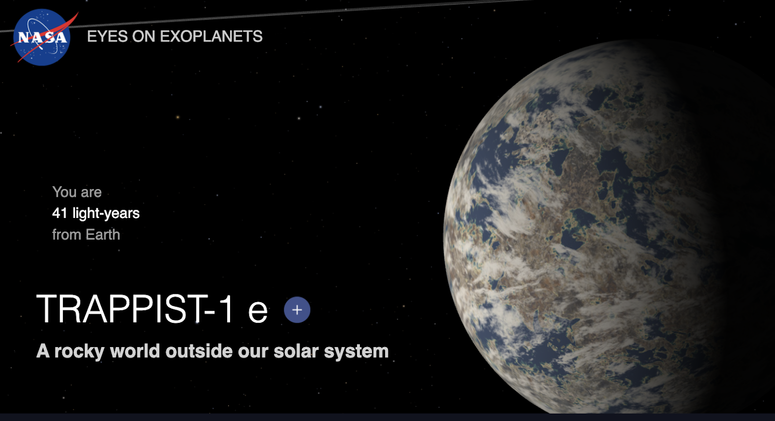
Estimating Photosynthetic Potential on TRAPPIST-1e through Net Primary Production
What is Net Primary Production?
A measure of new biomass growth within a certain area over a specific amount of time
What are our inputs for the Net Primary Production Model? -Light
-Temperature
-Precipitation
Is there life on TRAPPIST-1e?
Can we predict the evolutionary stage of this planet?

Slide 4
Comparison of Evolutionary Timelines
EARTH
SCL
MCL
10 BILLION YEARS AGO
9 8 7 6 5 4 3 2 1
SCL
MCL
TRAPPIST-1E
SCL = Simple cellular life
MCL = Multicellular life

Slide 5
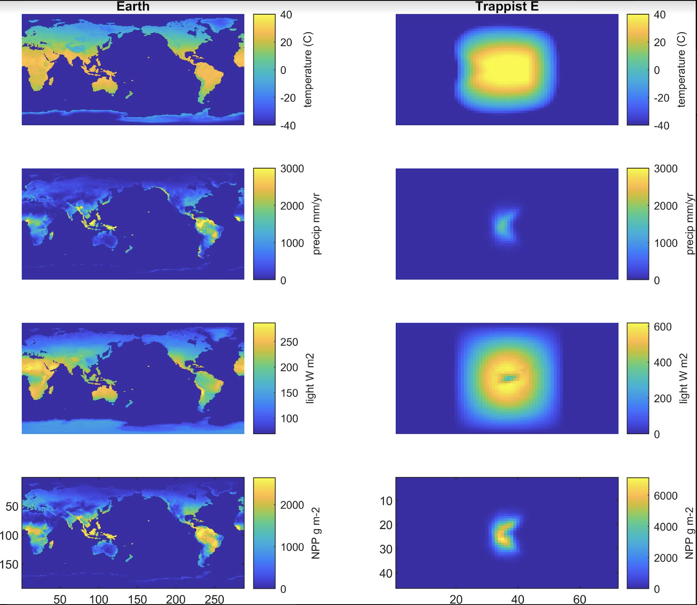
Our
Photosynthetic Life Model Outputs
EARTH
TRAPPIST 1-E
TEMP
Comparison of Earth to TRAPPIST-1e in
Temperature
Precipitation
Light
Net Primary Production (NPP)
PRECIP
LIGHT
NPP

Slide 6
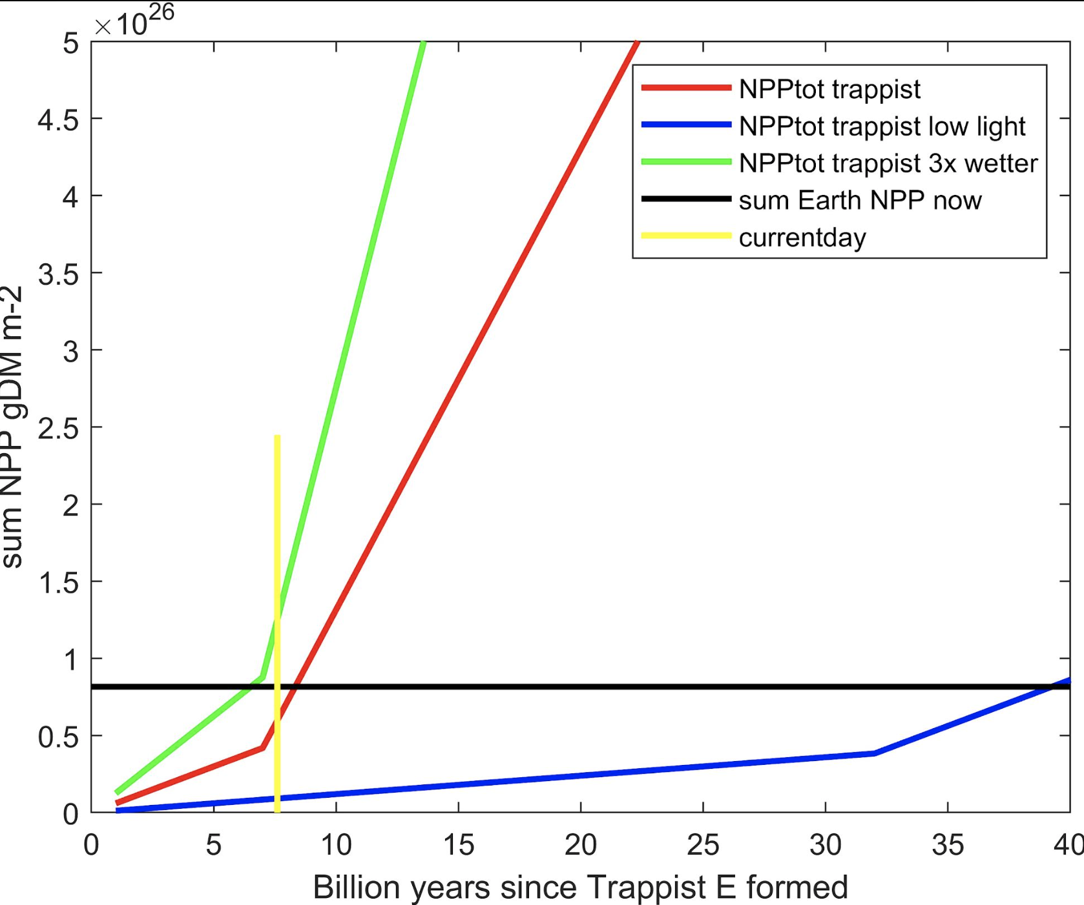
Photosynthetic Life Model Outputs
NET PRIMARY PRODUCTION
We hypothesize the planets evolutionary milestone
What is Carbon Fixed?
Conversion of atmospheric Co2 to organic molecules by autotrophic organisms
Carbon Fixed
Is TRAPPIST-1e evolutionarily ahead or behind us?

Slide 7
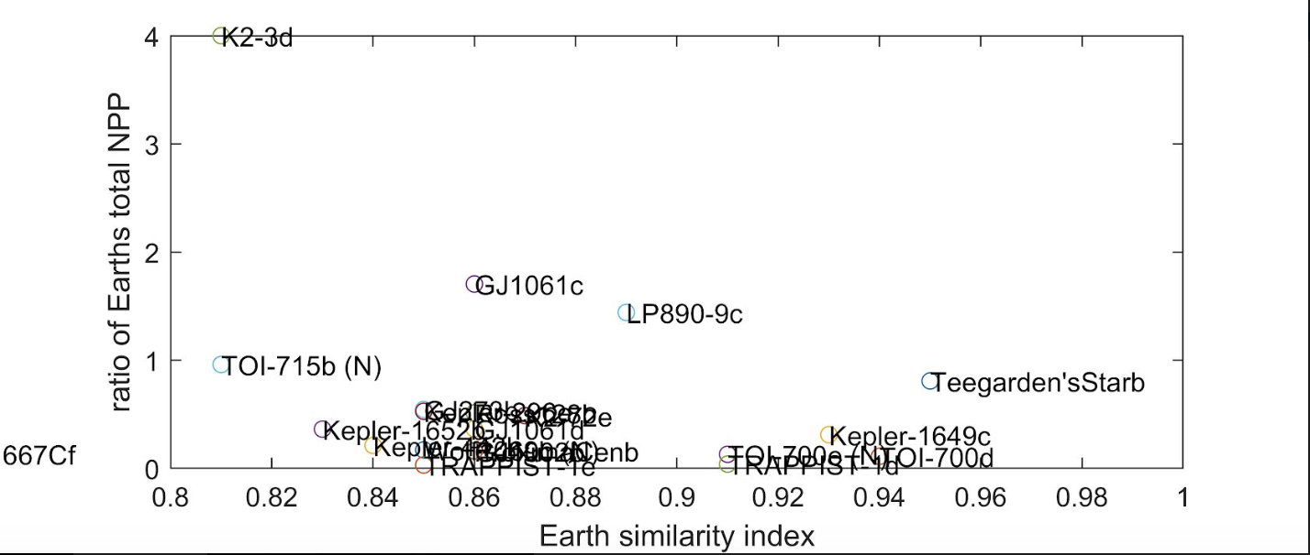
Earth Similarity Index
Earth Similarity Index takes into account various planetary measurements
Carbon fixed
We compared earth similarity index to whether each planet has fixed more (>1) or less (<1) carbon than Earth
Earth Similarity Index and ratio of Earth’s total NPP

Slide 8
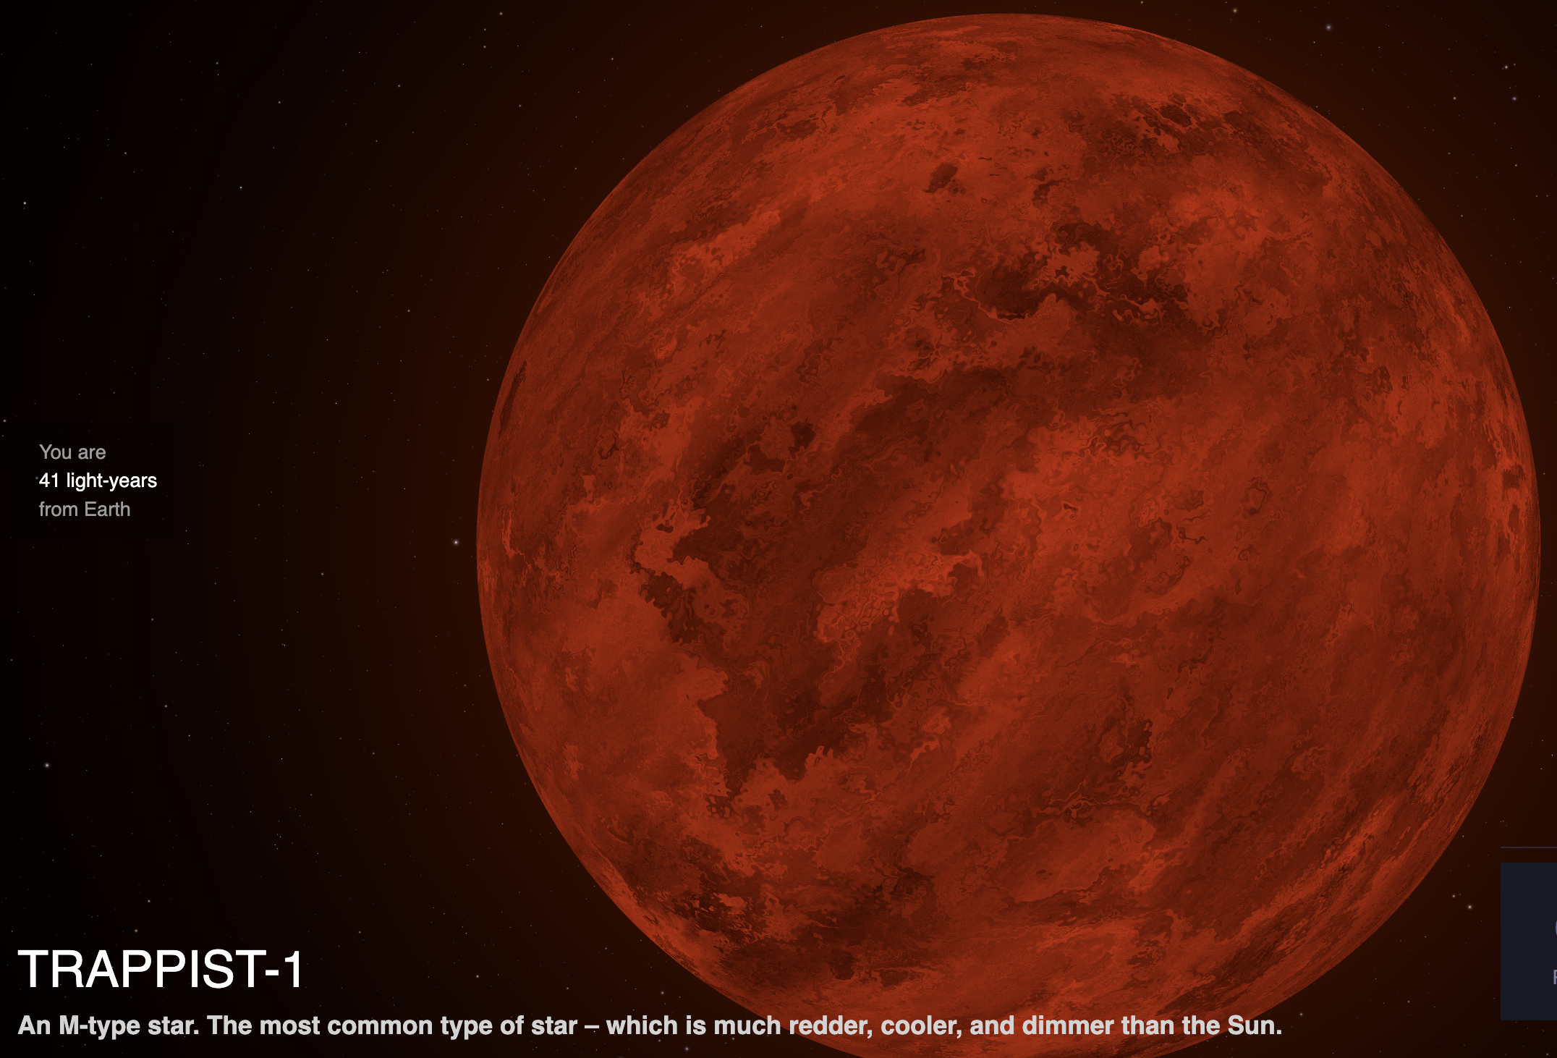
What Does the Future of Planetary Science Look Like?
New technological advancements such as the James Webb Space Telescope provide an exciting opportunity for planetary research and astrobiology
T R A P P I S T-1 R E D D W A R F S T A R

Slide 9
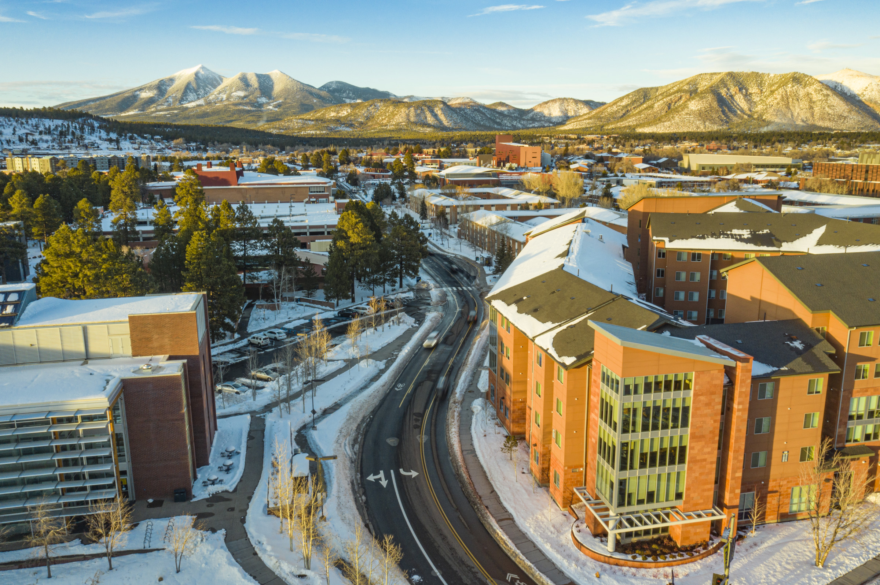
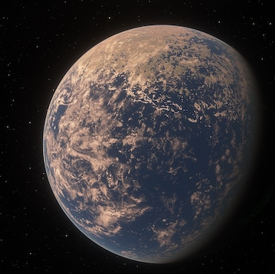
THANK YOU!
Special thanks to my professors Dr. Michael Gowanlock and Dr. Christopher Doughty for being so amazing and supportive throughout the whole process.

